Slide 1
Battle of the Bakers
By: Kristen Vrionis

Slide 2
The Business Problem
Cleo’s Cookies wants to open a new bakery in the Bay Area
About the Bay Area
Diverse and populous
Very competitive and expensive.
Factors to Consider in Analysis
Bay Area Counties
Cities Population
Cities Demographics
Are there any venues (offices, gyms, schools) nearby where “floating population” is high?
Who are the competitors in that location?
What classifies as a bakery (café, dessert, ice cream, etc.)?

Slide 3
The Data
Data Sources
Wikipedia
Geolocator Package
Foursquare API

Slide 4
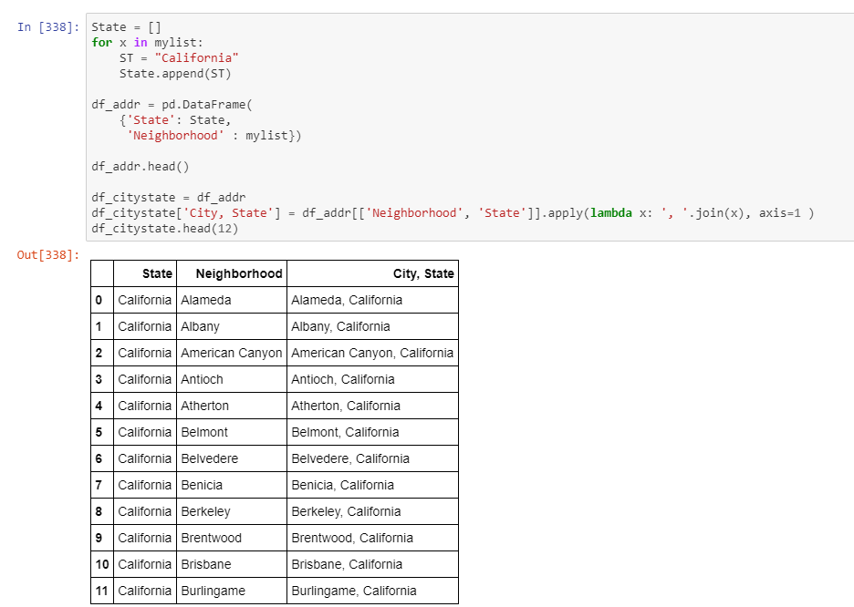
Wikipedia
County information, including which cities are part of each county and neighborhood demographics were found via Wikipedia (here).
Data Cleansing
In order to not have confusion when using Geolocator, I transformed the data and created a new column that would format the neighborhood name as “City, California”.

Slide 5
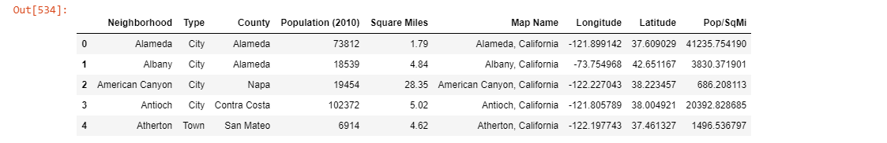
Geolocator
Now that the data was in the City, State format, I could use geolocator to determine the longitudes and latitudes of each city.

Slide 6
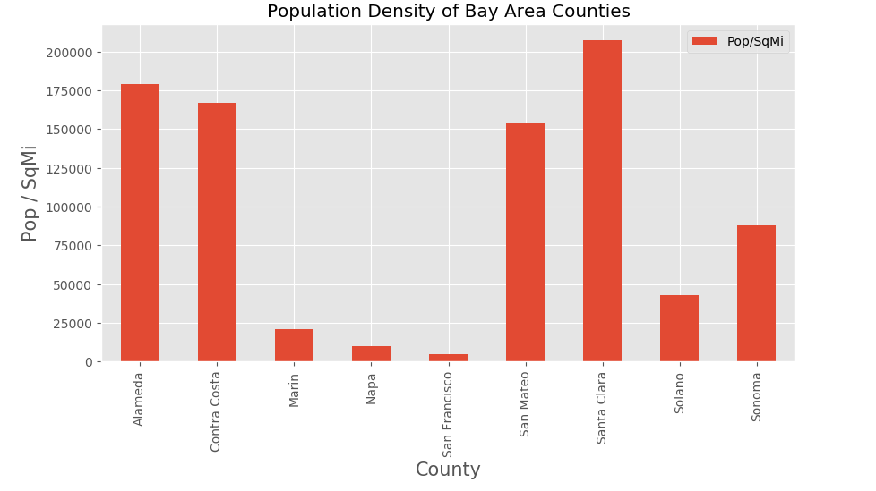
County Selection
9 counties total – needed to narrow down analysis
Narrowed down by population density
For each neighborhood I used the available data fields Population (as of 2010) and Square Miles to calculate population density

Slide 7
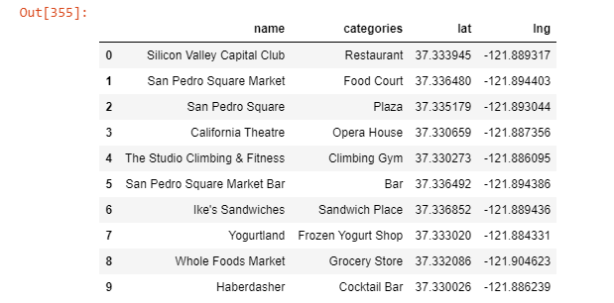
Venue Data from FourSquare API
Obtained the venue data for each of the three counties using Foursquare API.
Each data frame had a total of 100 entries. I took the data frames for each county (3 total).
I merged all the data frames and removed duplicates values to verify that all 300 data points were unique.
Shown below is an example of obtaining the venue data for Santa Clara county as well as the Santa Clara county venue data frame.

Slide 8
Identifying the Competition
Total of 245 unique venue categories
Determined that the three categories that were related to Cleo’s Cookies were: Bakery, Dessert Shop, and Café.
I filtered the for the desired venue categories and was left with 66 potential competitors for Cleo’s Cookies within the three selected counties.

Slide 9
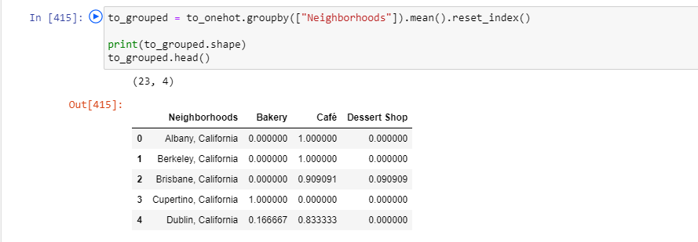
One Hot Encoding
Categorical Data is transformed into Numerical Data for Machine Learning algorithms.
All venues were then grouped by neighborhood and the average frequency of occurrence of each Venue Category was calculated.

Slide 10
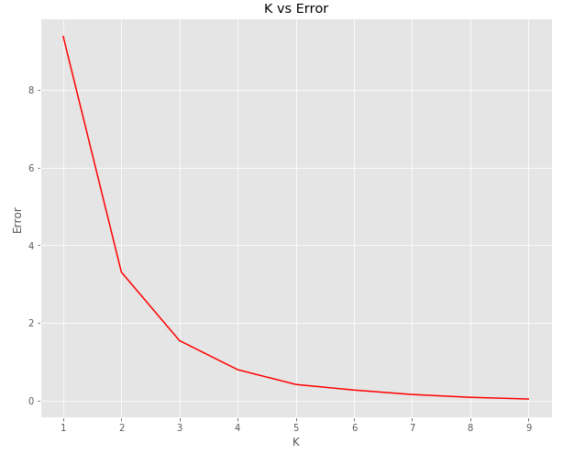
K-Means Clustering
Used the Elbow Point Technique, which is performed by running a test with different number of K values.
The optimal k value is two.

Slide 11
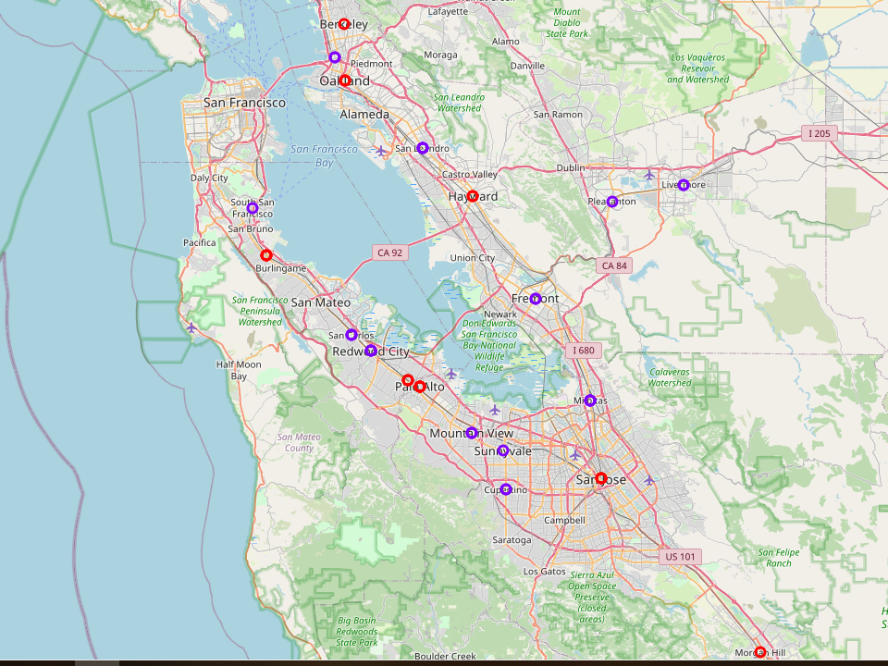
Create a Map
Using the clusters, a map was created using the Folium package in Python, where each neighborhood was colored based on the cluster label.

Slide 12
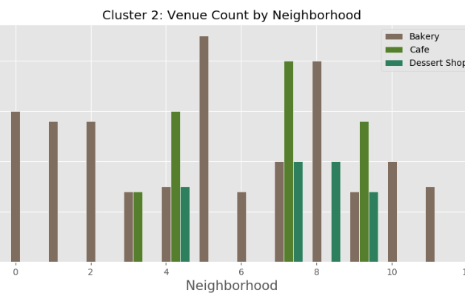
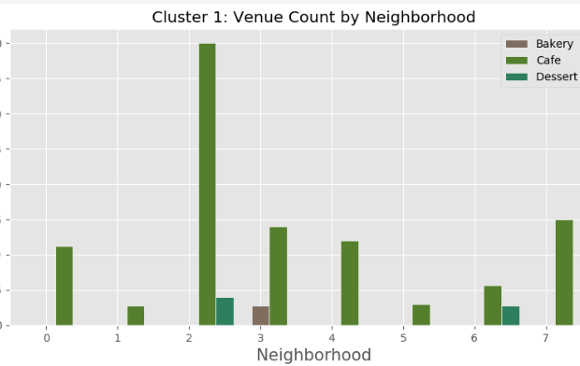
Cluster Analysis – Venue Count
First analyzed the frequency of venues in cities per cluster.
Cities in Cluster 1 have less bakeries and dessert shops than in Cluster 2.
Cluster 1 is less competitive for bakeries and dessert shops than Cluster 2.

Slide 13
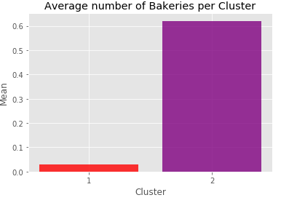
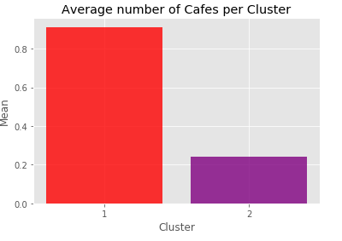
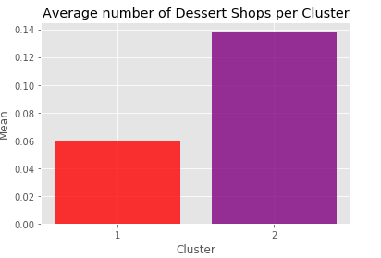
Cluster Analysis – Venue Category
In addition to determining the number of venues per neighborhood, a cluster analysis was performed for each venue category: Bakery, Café, and Dessert Shop. A bar chart was generated to aid in the visualization of the cluster analysis for each of these categories. The charts aid in supporting the earlier conclusion that Cluster 1 has less competition in the Bakery and Dessert Shop categories.

Slide 14
Discussion
Cities within Cluster 1 would be optimal choices to open a bakery in.
The cities that have both the highest population and density within Cluster 1 are Palo Alto, Dublin, and Brisbane.
Based on the performed analysis, I would recommend Cleo’s cookies to open a bakery either in Palo Alto or Dublin.

Slide 15
Conclusion
What I used and learned
I had an opportunity on a business problem, and it was tackled in a way like how a genuine data scientist would do.
I utilized numerous Python libraries to fetch the information, controlled the content, and analyzed and visualized those datasets.
Finally, I applied AI strategies that were taught through the data science course to come up with a final proposal on where a new bakery should be built in the Bay Area.
What I would change
I wouldn’t filter out the counties in the beginning.
I would be interesting to perform additional analyses on data points such as neighborhood incomes and facility rent prices.

